Slide 1
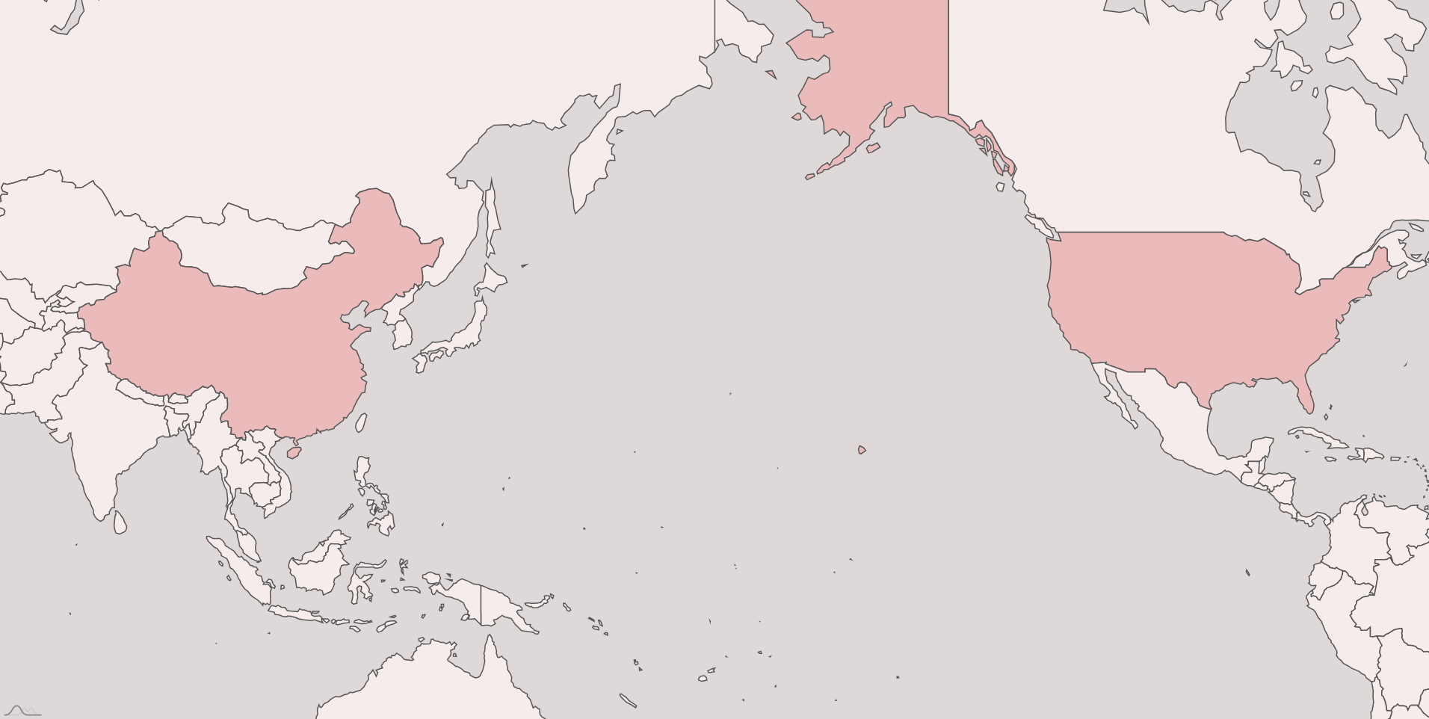

Shensheng
Yurui

Slide 2
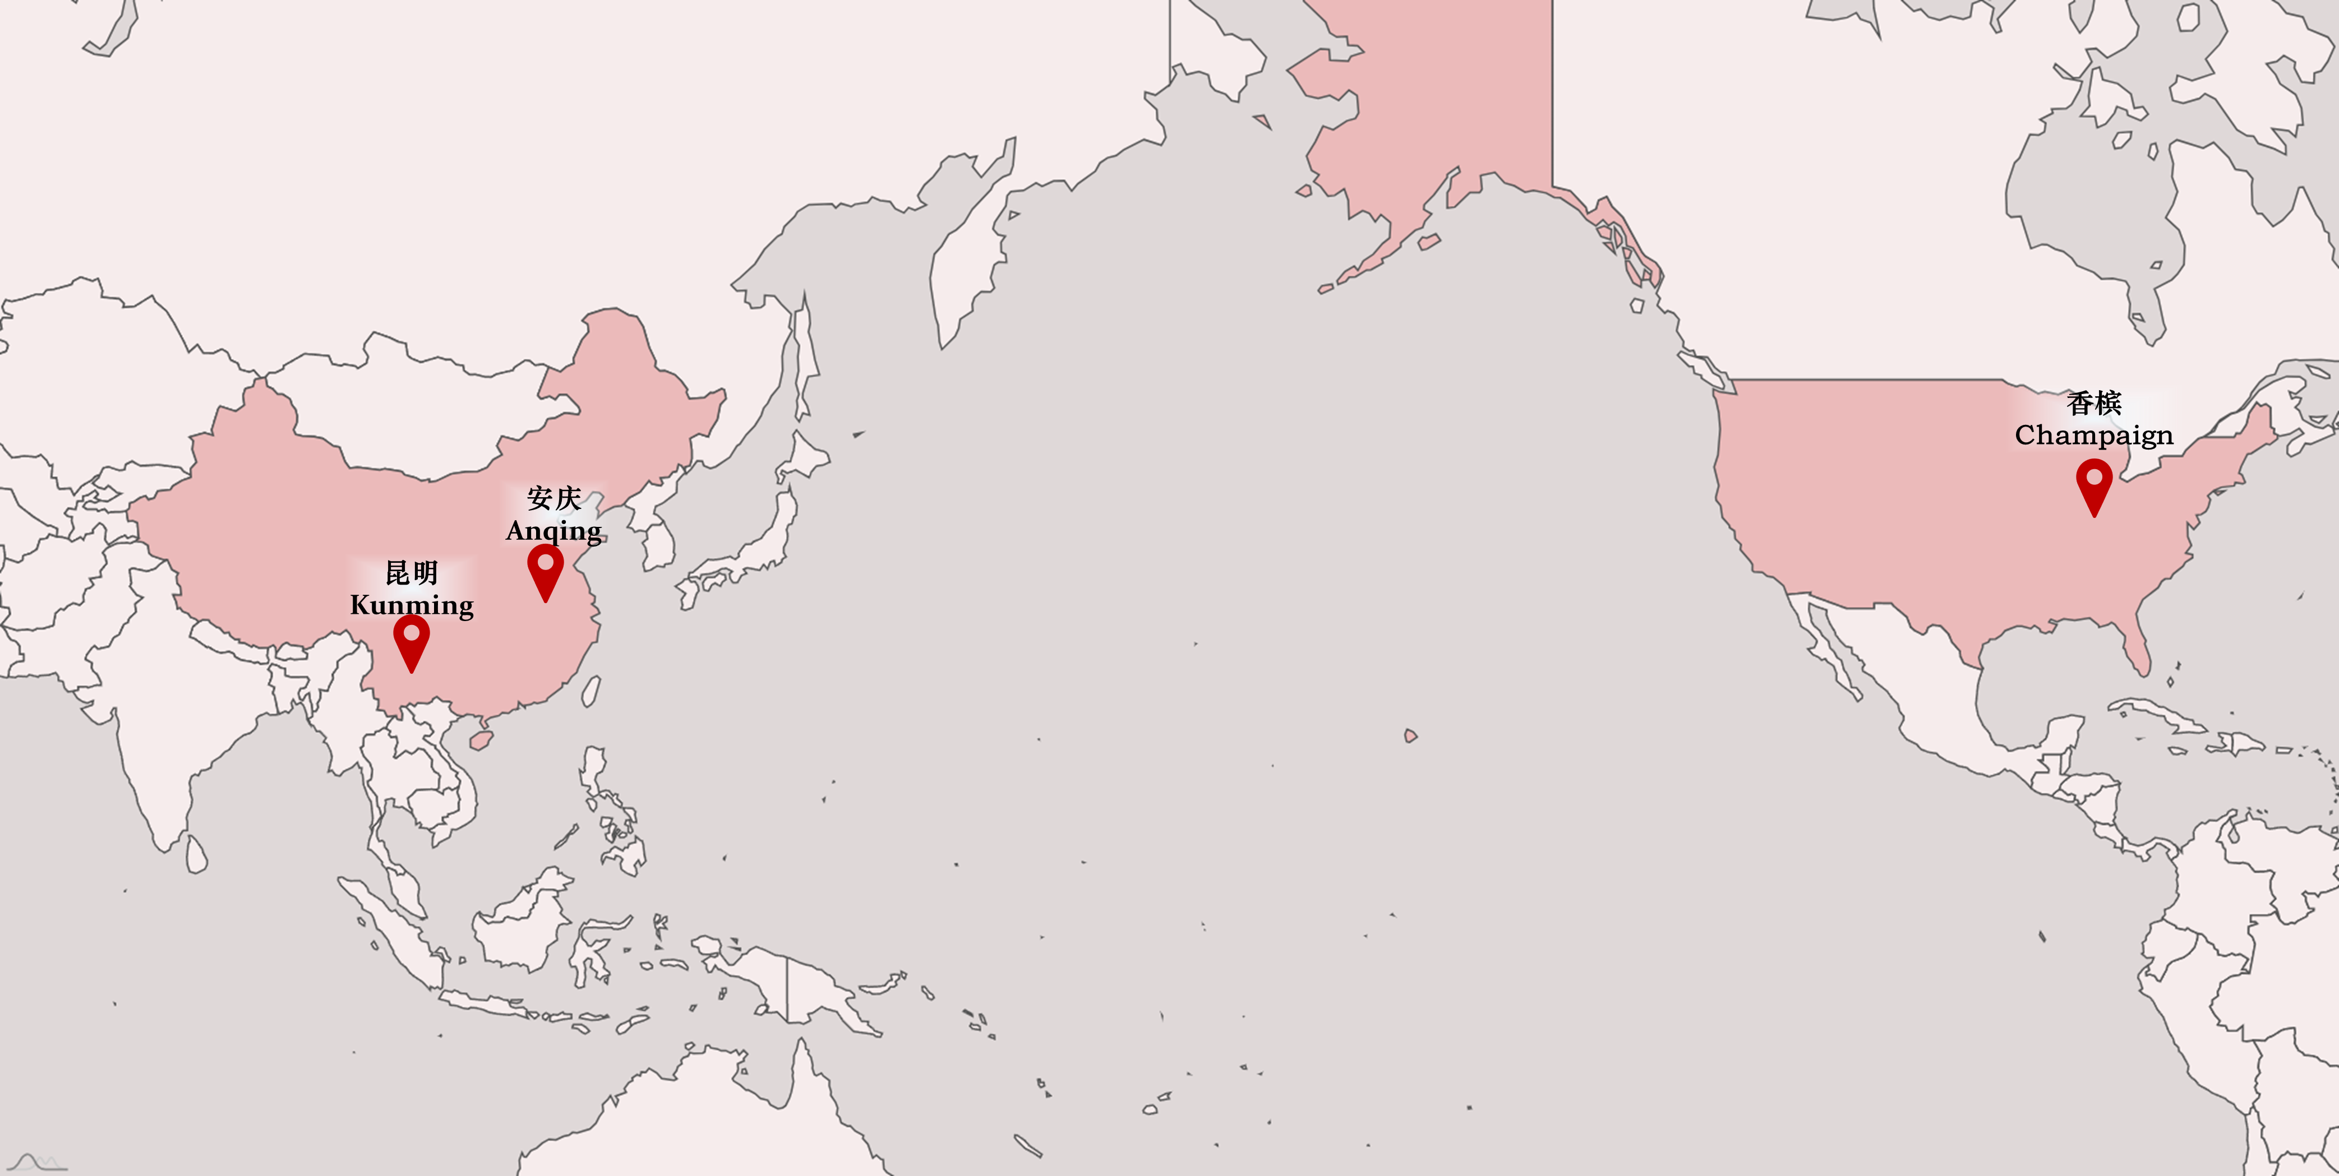

Shensheng
Yurui

Slide 3
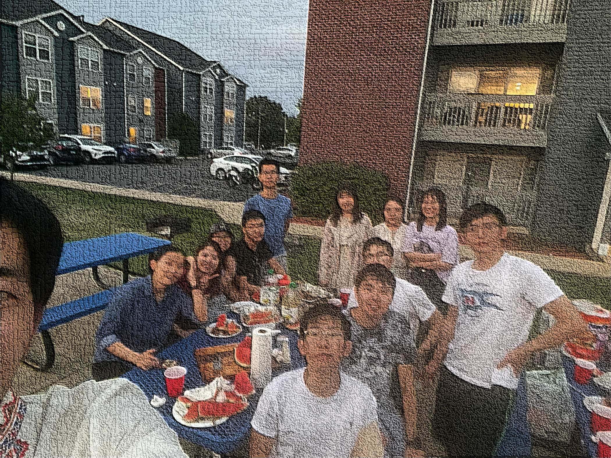


Slide 4
First meeting：Mid-Autumn Festival Sep 19th 2021

Slide 5

香槟Champaign
Shensheng
安庆Anqing
Yurui
昆明
Kunming

